Slide 1




NEXT GEN EMPLOYABILITY PROGRAM
Creating a future-ready workforce
Team Members
College Name
Student Name : R.Subbashinaa
Student ID :311121205054
Loyola ICAM College of Engineering and Technology

Slide 2

CAPSTONE PROJECT SHOWCASE
Project Title
MUSIC WEB APPLICATION USING DJANGO FRAMEWORK
Abstract | Problem Statement | Project Overview | Proposed Solution | Technology Used | Modelling & Results | Conclusion

Slide 3
Abstract The project endeavors to develop a music web application using Django framework to cater to the modern-day demands of music enthusiasts. It seeks to offer a personalized and seamless music streaming experience that aligns with users' preferences and browsing habits. Through the utilization of Django's robust features, the project aims to revolutionize the way users discover, organize, and share music online. Emphasis is placed on creating a user-friendly interface that enhances accessibility and engagement across various devices. The project strives to address existing challenges in playlist management, recommendation algorithms, and social integration prevalent in current music streaming platforms. By combining innovative technology with user-centric design principles, the project aims to set a new standard for music streaming applications. Ultimately, the goal is to create a dynamic ecosystem that fosters a sense of community and discovery among music enthusiasts worldwide.
Source :

Slide 4
Problem Statement Current music streaming platforms often lack personalized features, resulting in a generic user experience that fails to cater to individual preferences. Playlist management functionalities are often rudimentary, making it challenging for users to curate and organize their music collections effectively. Existing recommendation algorithms may not accurately reflect users' tastes, leading to missed opportunities for discovering new music. Social integration features on music platforms may be limited, hindering users' ability to share and interact with friends and fellow music enthusiasts. User interface designs of some platforms may not be optimized for seamless navigation and accessibility across different devices and screen sizes. There is a need for a music streaming platform that prioritizes user engagement and offers a more interactive and community-driven experience.

Slide 5
Project Overview 1.The project aims to create a comprehensive music web application that provides users with personalized recommendations, intuitive playlist management tools, and seamless social integration. 2. Key features include user authentication, music catalog browsing, playlist creation and sharing, personalized recommendation algorithms, and social media integration. 3. The application will prioritize user experience by ensuring fast loading times, responsive design, and intuitive navigation. 4. Through collaboration with artists, labels, and music enthusiasts, the platform will offer a diverse selection of music content spanning various genres and styles. 5. Continuous updates and improvements will be made based on user feedback and emerging trends in the music industry. 6.The project will adhere to best practices in software development, including rigorous testing, version control, and documentation. 7. Ultimately, the goal is to create a music streaming platform that not only meets but exceeds the expectations of users, fostering a vibrant and engaged community of music lovers.
Source :

Slide 6
Proposed Solution
.
Scalable Infrastructure: Implement a scalable infrastructure using Django's robust backend capabilities to handle user authentication, data storage, and content delivery efficiently.
Advanced Recommendation Algorithms: Develop sophisticated recommendation algorithms leveraging machine learning techniques to analyze user behavior, preferences, and music metadata for personalized song suggestions.
Intuitive Playlist Management: Create intuitive playlist management features allowing users to effortlessly create, edit, and organize their playlists according to their mood, activity, or genre preferences.
Enhanced Social Integration: Improve social integration by enabling seamless sharing of music content across various social media platforms, fostering collaboration through collaborative playlists, and facilitating user-generated content creation.
Source :

Slide 7
Responsive Frontend Interface: Design a responsive frontend interface using HTML, CSS, and JavaScript frameworks to ensure an optimal user experience across desktops, tablets, and mobile devices.
Real-time Updates: Implement real-time updates for playlist changes and music recommendations, providing users with instant access to the latest content and ensuring a dynamic user experience.
Customization Options: Offer customization options such as theme selection, font size adjustments, and language preferences to cater to diverse user preferences and accessibility needs.
Seamless Cross-Platform Experience: Ensure a seamless cross-platform experience by synchronizing user preferences, playlists, and listening history across multiple devices, including web browsers and mobile applications.
.
Source :

Slide 8
Community Engagement Features: Introduce community engagement features such as user reviews, artist discussions, and fan forums to encourage interaction and collaboration among users and artists.
Continuous Improvement: Commit to continuous improvement through regular updates, bug fixes, and feature enhancements based on user feedback, emerging technologies, and industry trends to maintain the platform's relevance and competitiveness
Source :

Slide 9


Technology Used
Front-end
Back-end
Source :

Slide 10
Modelling & Results Efficient Data Modeling: Develop a streamlined data model that accurately represents user profiles, music metadata, and playlists, optimizing database performance and query efficiency. User Testing: Conduct user testing sessions to gather feedback on usability, feature effectiveness, and overall user satisfaction, iteratively refining the application based on user input. Performance Metrics Tracking: Implement tracking mechanisms to monitor performance metrics such as response time, server load, and database query execution time, identifying areas for optimization and ensuring smooth user experience. Bug Tracking System: Utilize a bug tracking system to log and prioritize reported issues, facilitating timely resolution and ensuring application stability. Analytics Integration: Integrate analytics tools to gather insights into user engagement, behavior patterns, and feature usage, guiding decision-making and driving continuous improvement efforts.
Source :

Slide 11
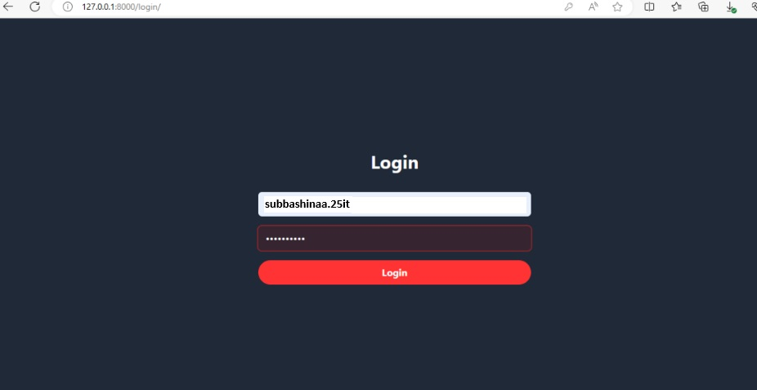
Homepage

Slide 12
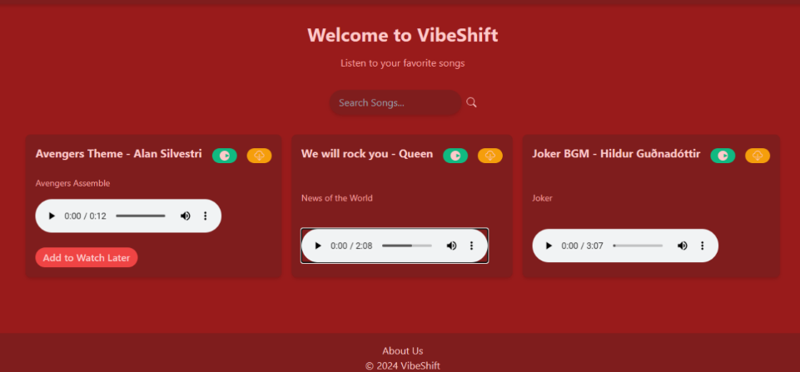
About-Us-Page

Slide 13
Future Enhancements:
Enhanced Social Features: Integrate social networking functionalities, enabling users to follow their favorite artists, interact with fellow music enthusiasts, and share playlists and music discoveries seamlessly across various platforms.
Smart Playlist Generation: Implement machine learning algorithms to automatically generate personalized playlists based on user preferences, listening history, and contextual factors such as time of day or activity, offering users curated music tailored to their tastes.
Live Concert Streaming: Introduce live concert streaming capabilities, allowing users to access virtual live performances from their favorite artists and bands, creating an immersive concert-going experience from the comfort of their homes
.Music Collaboration Tools: Develop collaborative music creation tools within the platform, enabling users to collaborate on music projects, remix tracks, and share their creations with the community, fostering a collaborative and creative music ecosystem.
Podcast Integration: Expand the platform to include podcasts and spoken-word content, providing users with a diverse range of audio content to discover and enjoy, and enhancing the platform's appeal to a broader audience.

Slide 14
Conclusion In conclusion, the development of a music web application using Django framework offers a comprehensive solution to the challenges faced by music enthusiasts in accessing and managing their favorite tunes. By leveraging Django's powerful features and integrating cutting-edge technologies, the project aims to deliver a seamless and personalized music streaming experience, thereby enhancing user satisfaction and engagement in the digital music landscape.
Source :

Slide 15
Thank You!
Notes:
Thank You !!

